Slide 1


Generative Diffusion Models for Audio Inpainting
Facoltà di Ingegneria dell’informazione, informatica e statistica
Engineering in Computer Science
Andrea Rodriguez
1834937
Advisor
Prof. Danilo Comminiello
Notes:
Good morning, today I’m presenting my thesis work. I experimented with generative diffusion models applied to audio inpainting. The focus of my work was in adapting the numerous techniques available for image inpainting to the audio domain, which is still mostly unexplored today.

Slide 2
Generative Diffusion Models for Audio Inpainting
Background
Diffusion models
Spectrograms
Audio generation and inpainting
State-of-the-Art for audio generation
AudioLDM
TANGO
Selected approaches for inpainting
DDNM and DDNM⁺
RePaint and RePaint⁺
Results and Evaluation
Audio inpainting in communication scenarios
Notes:
In this presentation I’ll first talk about the basic elements we need to know to understand the context. Then I’ll present the state-of-the-art models for audio generation. I’ll continue explaining the techniques that were used for inpainting and I’ll show the results. Finally I will discuss an additional use case regarding communication scenarios.

Slide 3
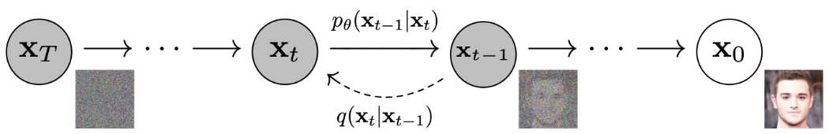
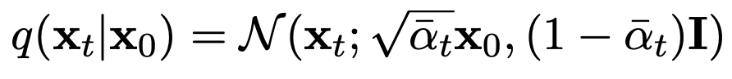
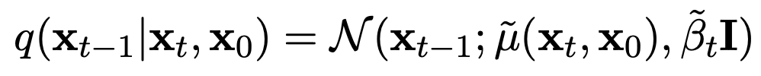
Diffusion models
Iteratively transform an initial noise distribution into a target distribution
Generate high-quality samples and perform denoising and inpainting
Main concepts
Forward process: using a variance schedule, small amount of Gaussian noise is added to the sample for T steps
Reverse process: the noise added at each step of the forward process is predicted and removed from the sample
Notes:
Let’s start with a background on diffusion models. They are a category of generative models which iteratively transform an initial noise distribution into a target distribution, to generate high-quality samples and perform a range of tasks such as denoising and inpainting. Diffusion models work in two phases. In the forward process a small amount of Gaussian noise is added to the input sample through a series of steps. The model, which is a UNet, learns this noise and to generate new samples we use the reverse process, which is shown in the image. Starting from random noise, the sample is refined step by step removing the noise predicted by the model.

Slide 4
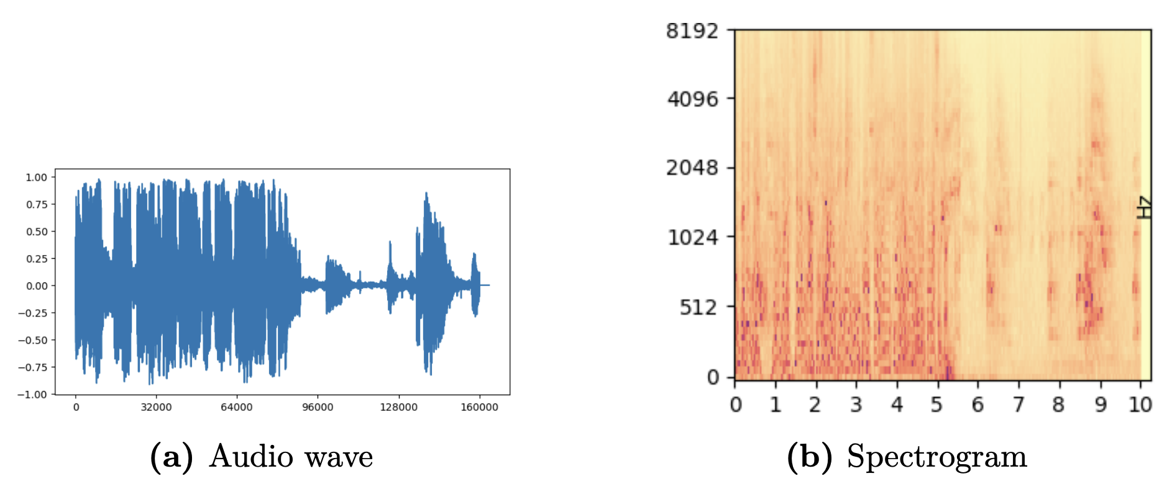
Spectrograms
A spectrogram is a visual representation that displays the frequency content of an audio signal over time
Vector 1 x 160000 (10 seconds)
Matrix 1024 x 64 (10 seconds)
Sparsity → Computationally demanding and Risk of overfitting
Dense representation → Capture long term dependencies and Efficient training
Notes:
We also need to understand spectrograms, which are a visual representation of the frequency content of an audio over time. When working with audio in machine learning, the choice of representation heavily impacts the efficiency and effectiveness of the models. Waveforms suffer from inherent sparsity, so models have to process and analyze a considerable amount of consecutive samples losing long-term dependencies and increasing the execution time. In contrast, spectrograms offer a compressed representation of audio data which allows the models to extract meaningful patterns. Moreover, the structure of a spectrogram resembles the structure of an image and we exploited this property.

Slide 5
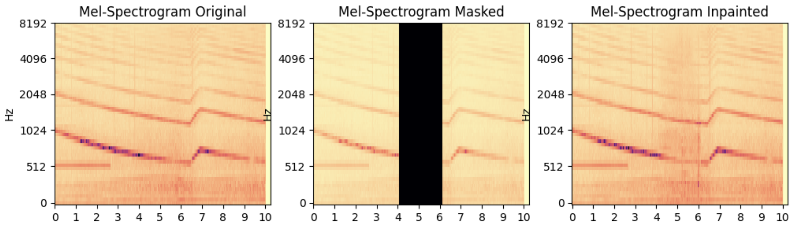
Audio generation and Audio inpainting
Produce audio from textual descriptions that is indistinguishable from human-created or real-world audio
Audio Generation
Generate audio samples with similar characteristics to the training data, also showcasing innovative attributes
Audio Inpainting
Reconstruct missing or corrupted portions of audio signals and restore the original audio content
Notes:
Audio generation is the process of creating new and realistic audio content. In this work we mainly discuss Text-To-Audio generation, which employs a textual description to generate the audio clips. Audio inpainting, instead, involves the reconstruction of missing portions of audio signals, aiming to restore the original audio content. The main goal is ensuring coherence and continuity in the inpainted audio, blending the generated portion into the available one. Deep learning methods are preferred because they have the ability to manage longer gaps than traditional methods.

Slide 6
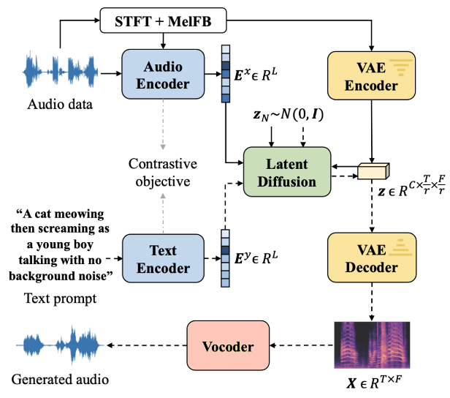
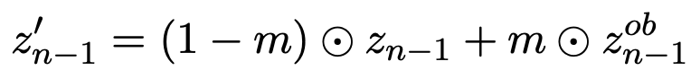
State-of-the-Art: AudioLDM
CLAP (Contrastive Language-Audio Pretraining): encode audio descriptions and audio clips into a shared audio-text embedding space
VAE (Variational Autoencoder): compress the spectrogram into a compact latent space
Latent Diffusion: the conditioning information is integrated into the feature extraction process
Vocoder: HiFi-GAN is employed to synthesize the audio waveform from the generated spectrogram
Inpainting: at each step of the reverse process, the latent representation z_{n-1} is modified using the mask m, the generated z_{n-1} and the known part of the audio z^{ob}
Notes:
AudioLDM is the first baseline we considered. It is a text-to-audio system based on a diffusion model, whose main characteristic is the use of a Contrastive Language-Audio Pretraining which can map both textual descriptions and audio clips in a shared latent space. In this way, during the training of the diffusion model, only audio clips are needed and there is no necessity to have also textual descriptions. During inference, instead, the encoded textual representation is used to generate a latent representation of the audio. The Variational Autoencoder reconstructs a mel-spectrogram from the obtained latent audio representation and the vocoder generates the final audio waveform. Inpainting has been implemented using a standard modification in the inference process, which combines at each step the known part of the audio clip with the generated one according to the mask.

Slide 7
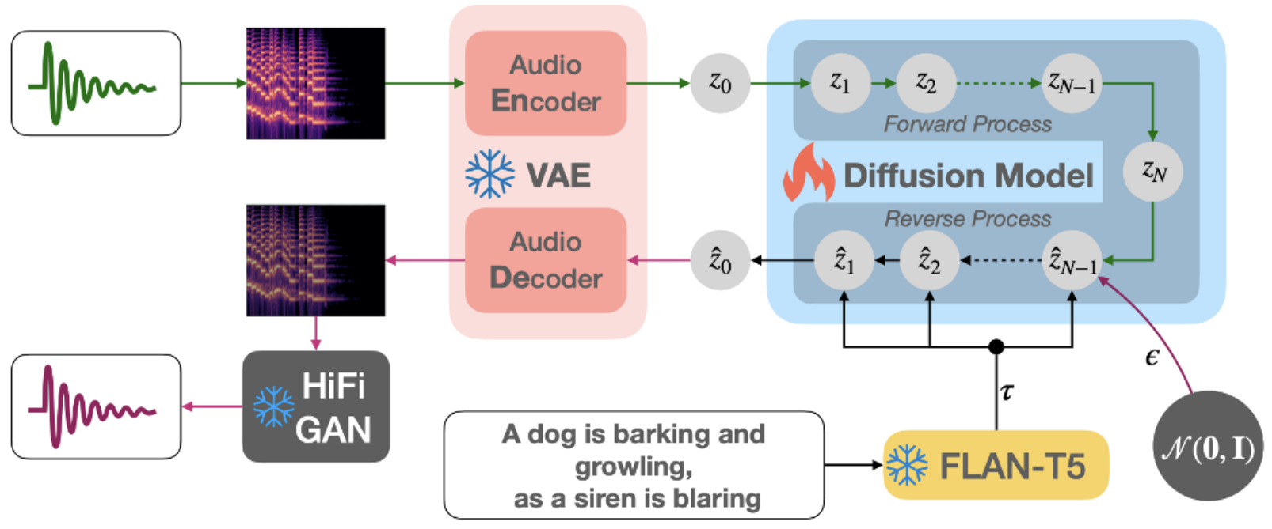
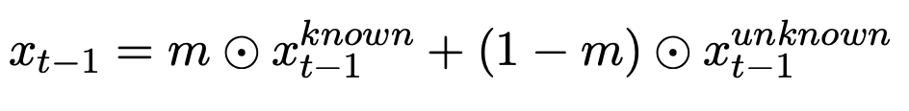
State-of-the-Art: Tango
FLAN-T5:
Instruction-tuned LLM architecture used as text encoder
Trained on a large-scale chain-of-thought and instruction-based dataset
Can learn new tasks mimicking gradient descent through attention weights
TANGO achieves comparable results compared to AudioLDM while extremely reducing the training dataset and time
Inpainting:
x^{known} is sampled from the known part
x^{unknown} is sampled from the model
The two components are combined using the mask m
Notes:
TANGO is another Text-to-Audio model. The Variational Autoencoder and the Vocoder are taken from AudioLDM. Its main novelty lies in the adoption of FLAN-T5, which is an instruction-tuned Large Language Model used as text encoder for the audio captions. Even if the diffusion process has to learn also the inter-modality mapping, this architecture demonstrates superior performance compared to AudioLDM. Moreover, a key improvement of Tango over AudioLDM is that the Latent Diffusion Model is trained on a 63 times smaller dataset, which reduces the training cost. In this case we implemented a basic inpainting method following the same technique employed by AudioLDM.

Slide 8
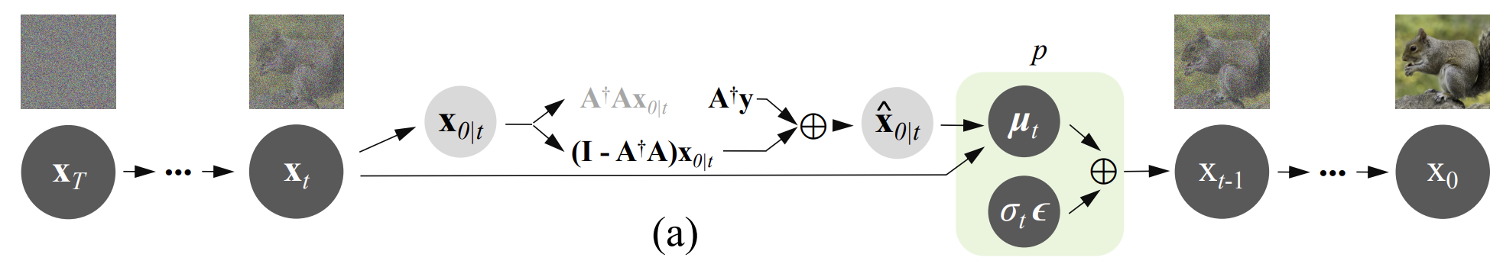
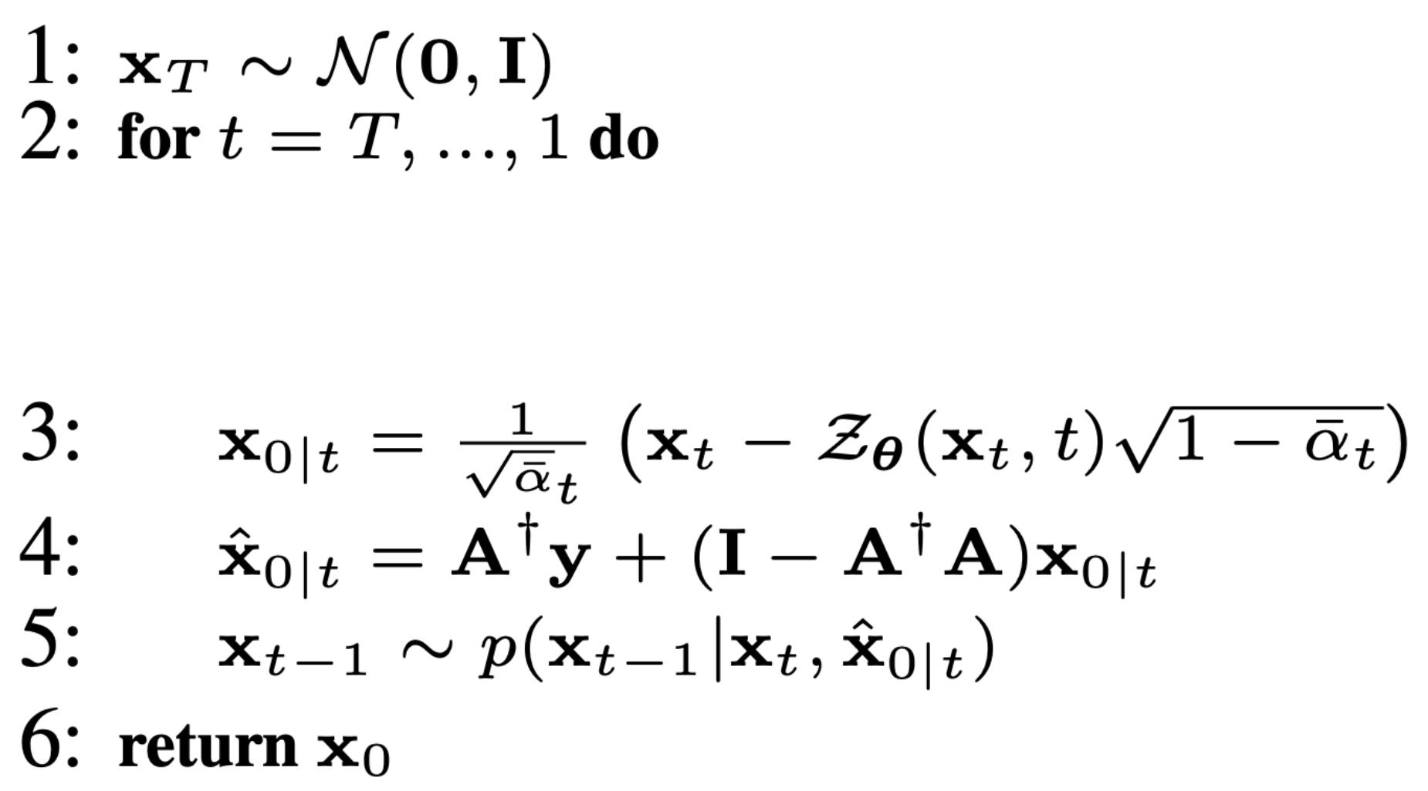
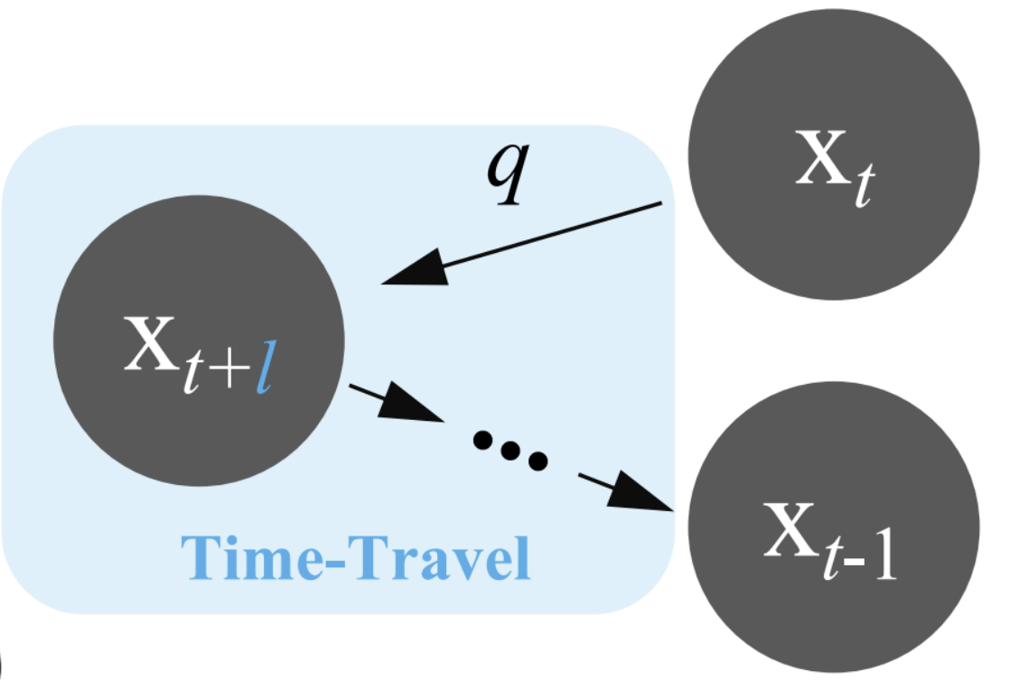
Selected Approaches: DDNM and DDNM⁺
DDNM (Denoising Diffusion Null-Space Model) is a framework for image restoration which refines the null-space content during the reverse diffusion process to produce results that satisfy data consistency and realism
Task: reconstruct x̂ from y where y = Ax
DDNM⁺: Through the time-travel trick we generate a better “past”, which in turn leads to a better “future”
Notes:
Now I’ll focus on the techniques we applied to the inference process to perform audio inpainting. Recall that these techniques were originally designed for images but we adapted them to work with the latent representation of the audio samples, leveraging the structure of spectrograms. The Denoising Diffusion Null-Space Model is a framework that addresses various image restoration problems, including inpainting. It focuses on refining the null-space content during the reverse diffusion process, to produce results that satisfy both data consistency and realism. There is also an enhanced version of this method, DDNM+, which incorporates the time-travel trick, a modification inspired by RePaint which we’ll describe now.

Slide 9
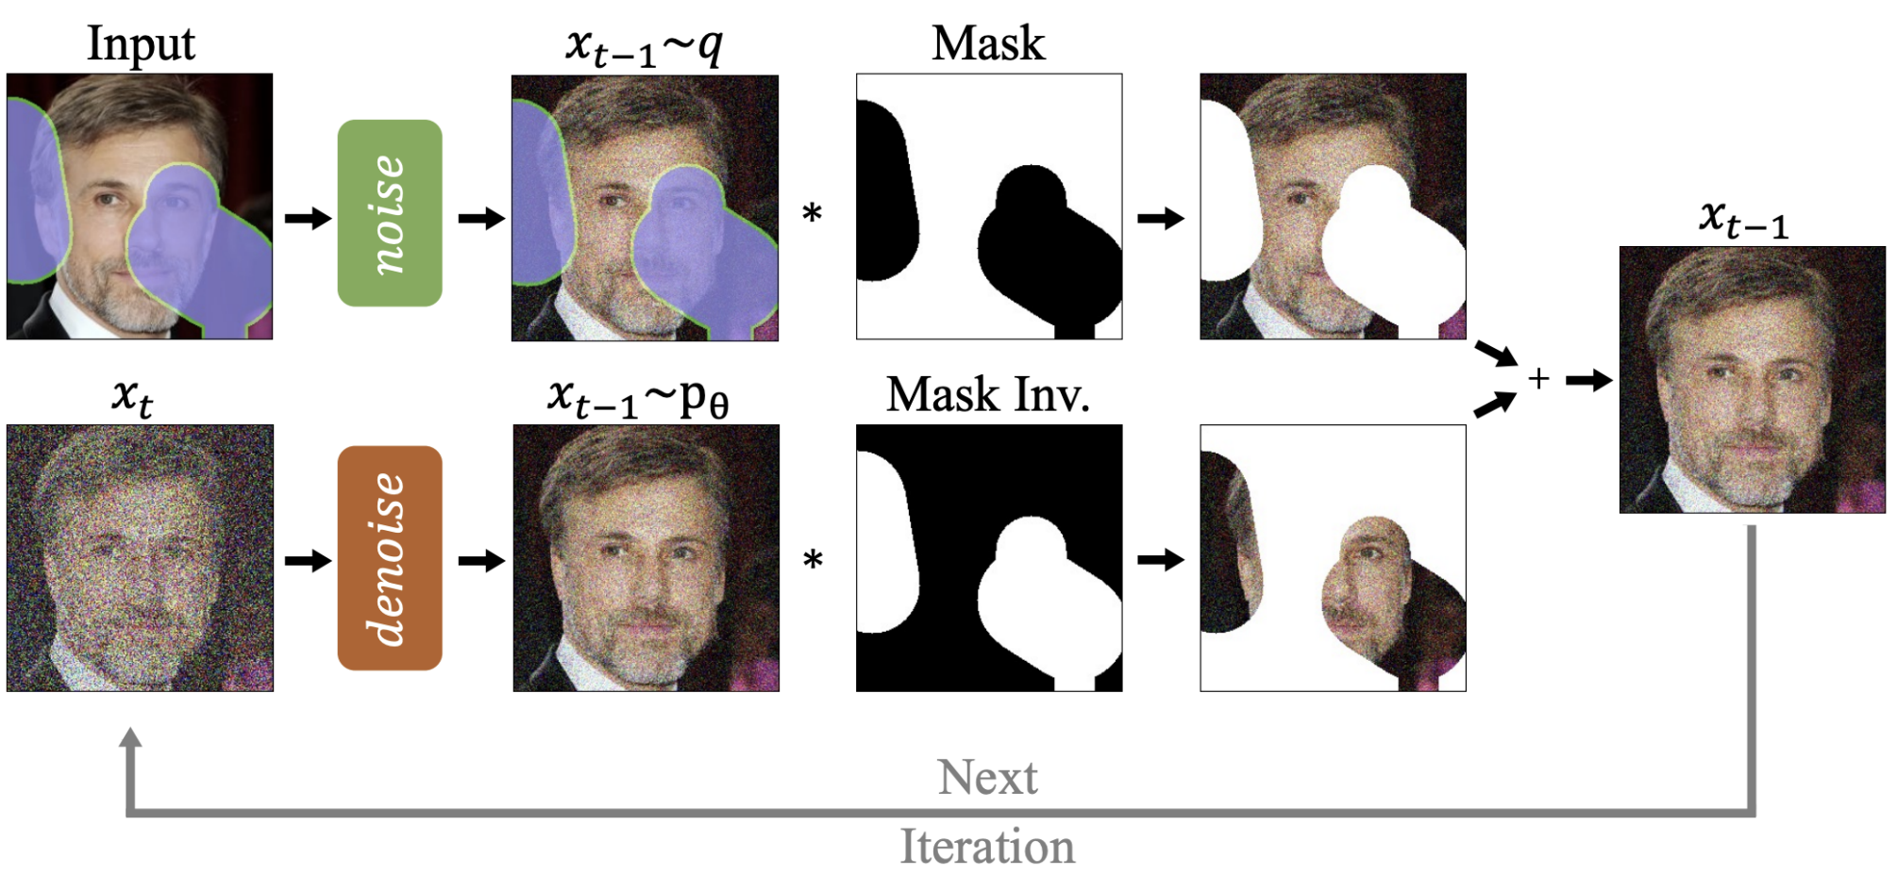
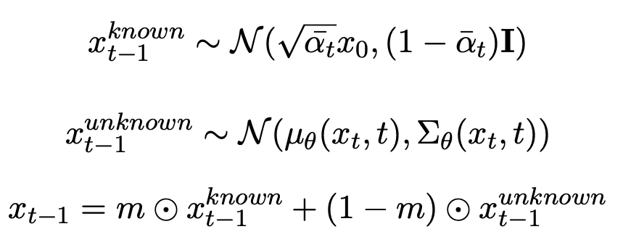
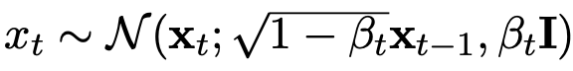
Selected Approaches: RePaint and RePaint⁺
RePaint: sample the unmasked regions using the available information as conditioning during the diffusion process
x_{t-1} is diffused back to x_{t}
the denoising step is performed again
The model has more time to effectively incorporate the provided information with the generated part
RePaint⁺: The latent representation is diffused back to multiple previous steps and then all of them are sequentially performed again
Notes:
RePaint is again an image inpainting approach, which we adapted to the audio domain. The generation process is conditioned by sampling the unknown regions using the available part. To effectively blend the generated information in the known part, the resampling approach is introduced. The output of a step is diffused back to the previous one and the sampling is performed again. Despite adding noise in the diffusion step, some information is still retained and used to generate a more harmonized output. An enhanced version, RePaint+, is also proposed to increase the performance. In this version the latent representation is diffused back to multiple previous steps which are then performed again.

Slide 10

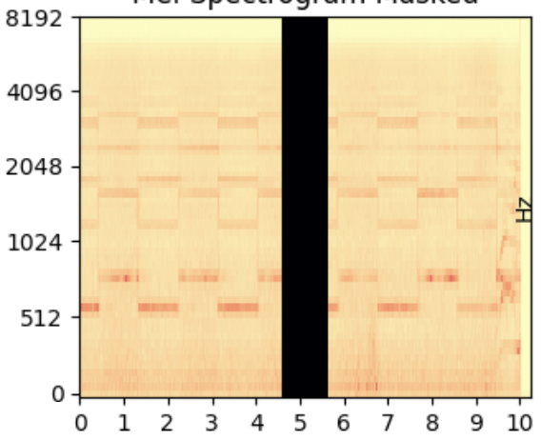
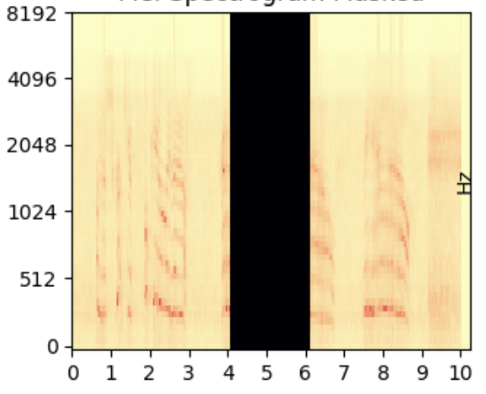
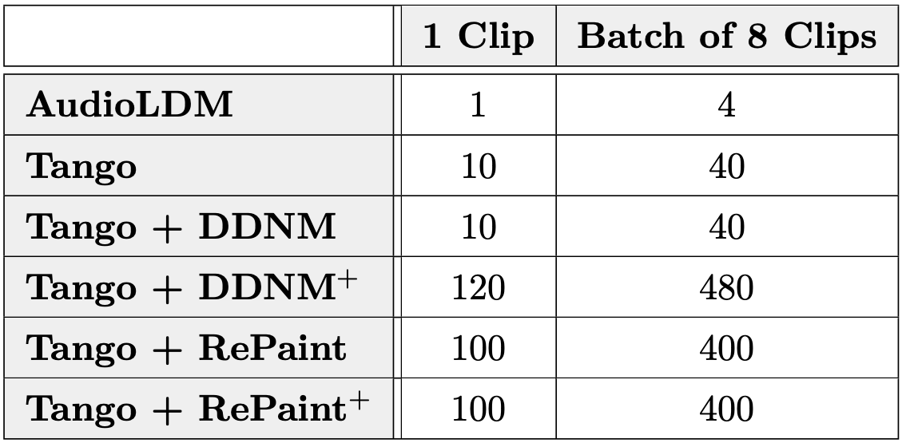
Audio samples and Inference details
Tests were done using 24 audio clips from the AudioCaps dataset
“Female and male are having conversation”
“An emergency vehicles’ siren with a brief male yell”
“Duck quacking repeatedly”
Inference times in minutes using one GPU NVIDIA Tesla T4
1 second gap
2 seconds gap
Listen to the audio clips at: https://www.andrearodriguez.it/inpainting
Notes:
We tested the two baselines and the four selected techniques using 24 audio clips from the AudioCaps dataset. These clips are 10 seconds segments from youtube videos with a human written caption. The chosen audio samples include speech clips [esempio], audios with an evident pattern in the spectrogram [esempio] and a mixture of different sounds [esempio]. The two described techniques DDNM and RePaint, together with their enhanced versions, were applied to the inference process of the generative model Tango. We tested the inpainting capabilities adding both one and two seconds gaps in the middle of each audio clip. It is also important to consider that while a method may achieve better results, the trade-off with longer inference times may not be favorable in scenarios in which low latency is crucial.

Slide 11
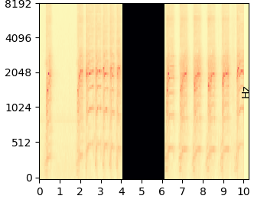
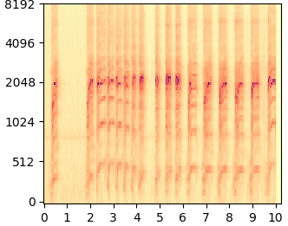
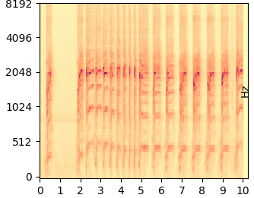
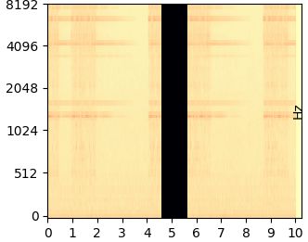
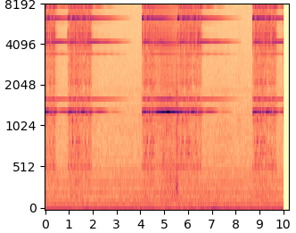
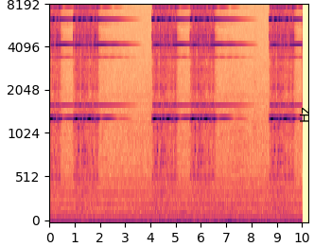
Results
“Duck quacking repeatedly”
Masked
Inpainted using RePaint
Original
“A telephone ringing”
Notes:
Let’s listen to some results to give you an idea of what are the capabilities of these techniques. I chose two audio clips inpainted using RePaint as it consistently reported better results. The first clip contains a duck quacking, here is the masked sample [masked] and the inpainted one [inpainted]. The second clip is instead of a telephone ringing [masked] [inpainted]. In this clip you can see from the spectrograms that the model didn’t reconstruct exactly the original audio. However, in certain use cases, the reconstruction of a plausible waveform can be considered a successfully inpainted clip.

Slide 12
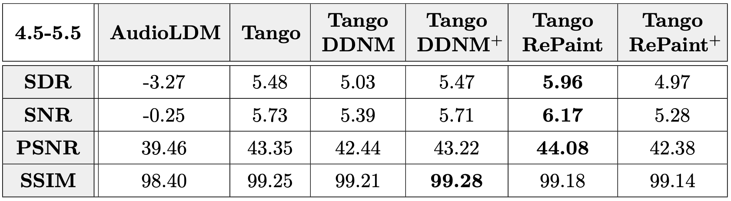
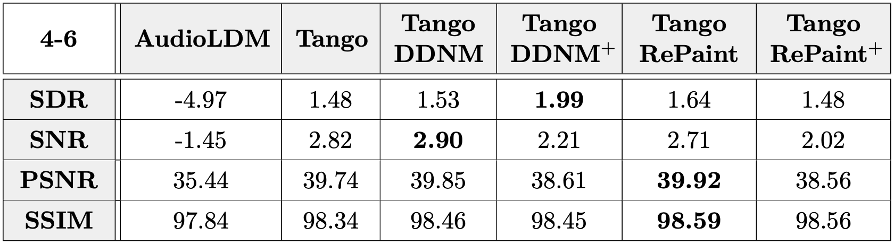
Metrics
SDR = Signal Distortion Ratio
SNR = Signal Noise Ratio
PSNR = Peak Signal Noise Ratio
SSIM = Structural Similarity Index Measure
1 second gap
2 seconds gap
* SSIM values are multiplied by 100
Notes:
We evaluated the results using four different metrics. The signal-to-distortion ratio and the signal-to-noise ratio were computed on the resulting waveform, while the peak signal-to-noise ratio and the Structural Similarity Index were computed on the spectrograms. In these tables you can see the averages over all the 24 clips. From these results we can clearly see that the two baselines fall short in comparison to the other approaches. Moreover, RePaint consistently achieves superior results compared to the other methodologies.

Slide 13




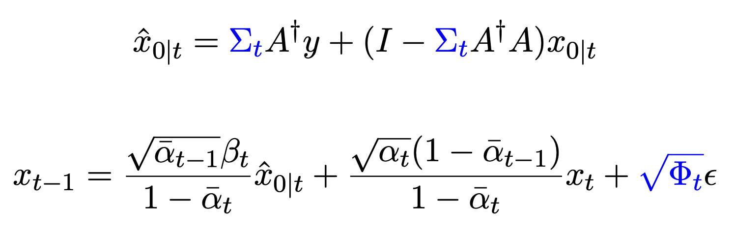
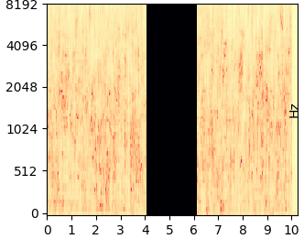
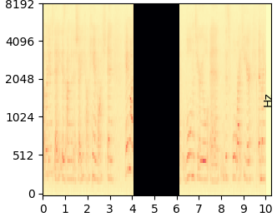
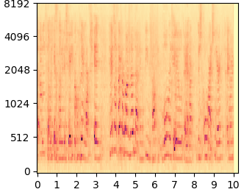
Audio inpainting in communication scenarios
We tested the technique adding white Gaussian noise to some audio clips and then trying to remove it
Noisy channel
Sender
Receiver
We worked with PSNR 20 and 30
DDNM+: introduces a new parameter σ_{y} which represents the estimated noise level that we aim to eliminate from the audio signal
DDNM⁺ for denoising
DDNM for inpainting
Notes:
The methods explored so far have demonstrated their effectiveness in audio inpainting. However, we also considered an additional scenario in which audio is transmitted through a noisy communication channel where the signal is corrupted. Most techniques address this issue sending additional data to reconstruct the signal. However, in cases where only the semantic information is needed it may be enough to predict the original audio. We used a version of DDNM+ which includes denoising capabilities and tested it using four audio clips with added noise. We tried a peak signal-to-noise ratio of 20 which significally affects the quality of the audio, and a psnr of 30 which only have a slight impact on the signal. The denoising and inpainting capabilities were further combined to have a complete architecture.
[semantic information refers to information which is in some sense meaningful for a system]

Slide 14
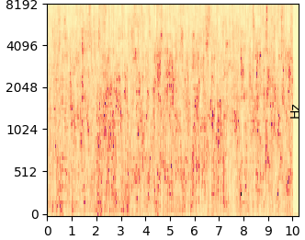
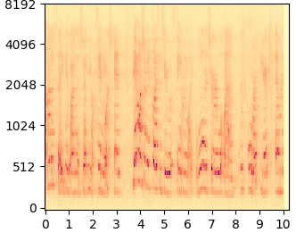
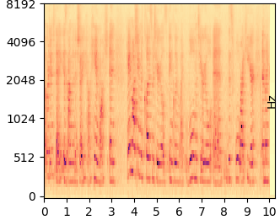
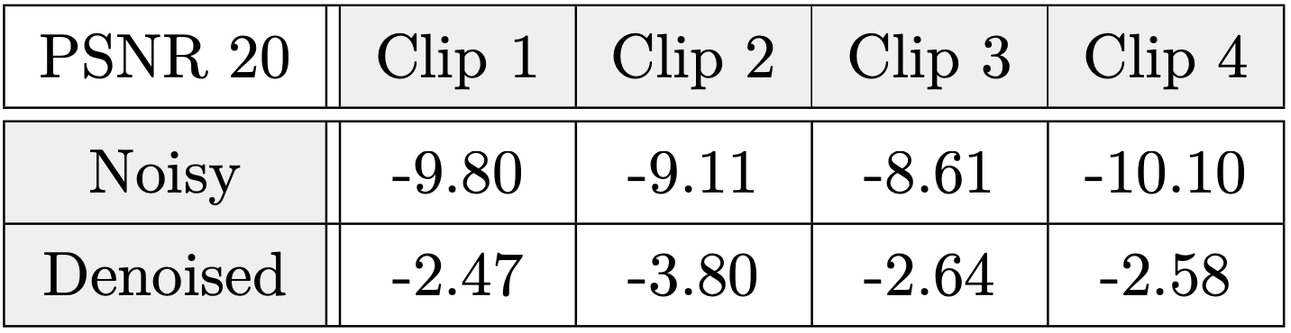
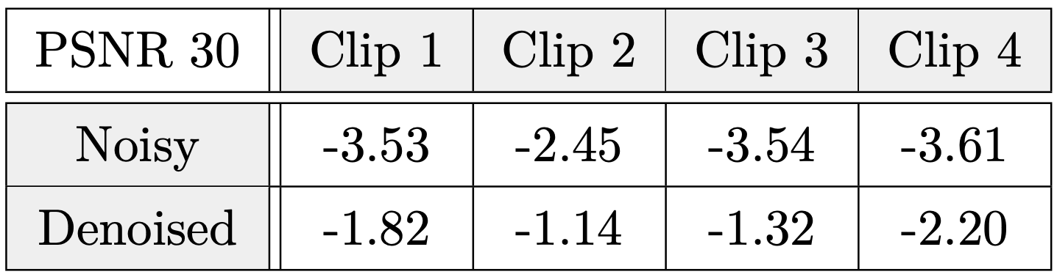
Results
“An adult female is speaking in a quiet environment”
Noisy
Denoised
Original
SNR
SNR
Notes:
Here you can have a glimpse of the denoising capabilities of the chosen technique. Starting from this noisy version [noisy], the model predicted this denoised version [denoised] which is almost identical to the original audio [original]. The validity of the results is confirmed by the Signal-to-Noise ratios computed before and after the application of the denoising technique. You can see in the tables that in all cases the snr improves in the denoised version of the sample.

Slide 15
Conclusions
The proposed techniques achieve better results than the two baslines
RePaint consistently achieves superior results compared to the other methodologies
It is crucial to consider the trade-off between quality and inference time
and Future works
Create an automated communication system which performs denoising and intelligently identifies and inpaints problematic segments
Remove conditioning from text and perform inpainting based only on the known portion of audio
Notes:
Finally let’s draw the conclusions. The proposed techniques showed objectively better results than the two baslines. Among the selected methods, RePaint consistently achieves superior results compared to the other methodologies. However, it is crucial to consider the trade-off with inference time, as RePaint requires approximately 10 times longer than DDNM. Therefore, when selecting an appropriate method, both the performance metrics and the associated inference time should be taken into account. To carry on our research, two ideas could be further explored. The former regarding the creation of a communication system to automatically identify the problematic segments after denoising and inpaint them. The latter regarding inpainting without a text description, using only the known portion of the audio as conditioning. That’s all for my presentation. We are also working on an academic paper regarding this work. Thank you for the attention and have a good day!

Slide 16
References
Jonathan Ho, Ajay Jain, and Pieter Abbeel. Denoising Diffusion Probabilistic Models. 2020. arXiv: 2006.11239 [cs.LG].
Haohe Liu et al. AudioLDM: Text-to-Audio Generation with Latent Diffusion Models. 2023. arXiv: 2301.12503 [cs.SD].
Deepanway Ghosal et al. Text-to-Audio Generation using Instruction-Tuned LLM and Latent Diffusion Model. 2023. arXiv: 2304.13731 [eess.AS].
Yinhuai Wang, Jiwen Yu, and Jian Zhang. Zero-Shot Image Restoration Using Denoising Diffusion Null-Space Model. 2022. arXiv: 2212.00490 [cs.CV].
Andreas Lugmayr et al. RePaint: Inpainting using Denoising Diffusion Probabilistic Models. 2022. arXiv: 2201.09865 [cs.CV].
Chris Dongjoo Kim et al. “AudioCaps: Generating Captions for Audios in The Wild”. In: Proceedings of the 2019 Conference of the North American Chapter of he Association for Computational Linguistics: Human Language Technologies, Volume 1 (Long and Short Papers). Minneapolis, Minnesota: Association for Computational Linguistics, June 2019, pp. 119–132. doi: 10.18653/v1/N191011. url: https://aclanthology.org/N19-1011.

